Slide 1
Introduction to Information Assurance
CSE 365 – Information Assurance
Spring 2022
https://cse365.io

Slide 2
Course Setup
Hybrid course, so half of your classes will be in-person, half will be remote (over zoom)
Tuesdays, 9:00 AM – 10:15 AM
Thursdays, 9:00 AM – 10:15 AM
Attend your session in-person (if you want) and attend other session on zoom (or watch video recording)
If we have enough space in the room, feel free to attend in-person both sessions
Always available on zoom: https://asu.zoom.us/j/82198608380
Course website: https://cse365.io/
Piazza: https://piazza.com/asu/spring2022/cse365

Slide 3
Introduction
Professor Adam Doupé
PhD at UCSB
Played CTF with Shellphish, then started the pwndevils @ ASU, which is now the mysterious ASU Hacking Club
http://asuhacking.club
OH: Tuesdays, 10:30 AM – 11:30 AM
BYENG 472 or Zoom: https://asu.zoom.us/j/88211077168

Slide 4
Introduction
Professor Tiffany Bao
Assistant Professor, ASU CIDSE
PhD at CMU
Research: Software Security
https://www.tiffanybao.com/research.html
OH: Tuesday, TBA

Slide 5
TAs and UGTAs
Steven Wirsz
Robert Wasinger
Zeming Yu
Ati Priya Bajaj
TBA UGTAs

Slide 6
https://www.oooverflow.io/
https://github.com/o-o-overflow
https://twitter.com/oooverflow

Slide 7
Road to DEF CON 27 CTF
6 qualifying CTFs from around the world
1,200 teams competed in our qualification event in May

Slide 8
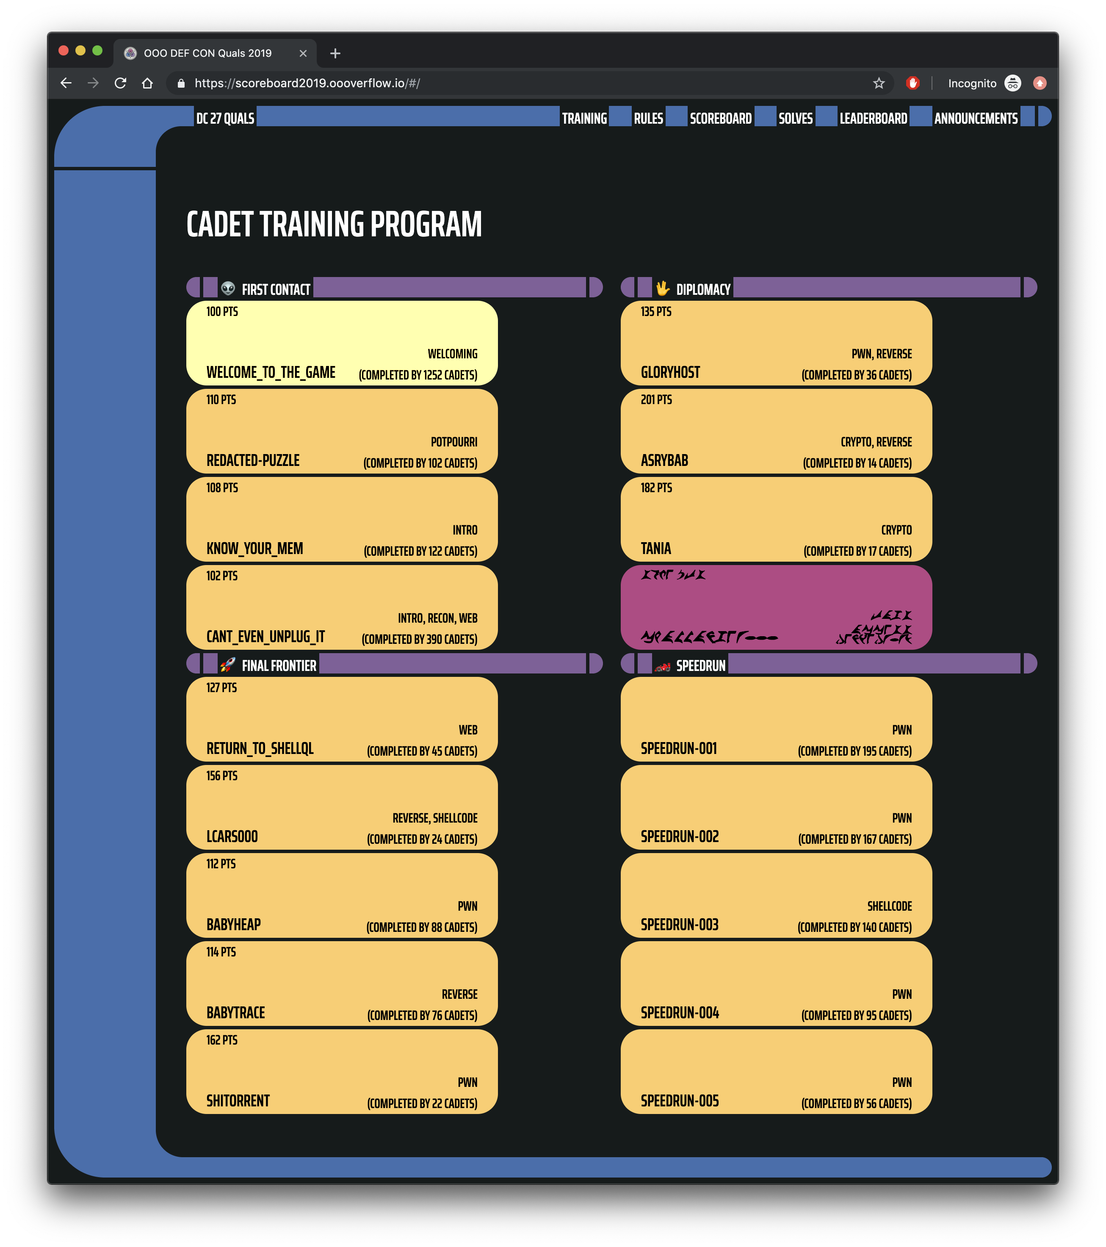
https://scoreboard2019.oooverflow.io/

Slide 9
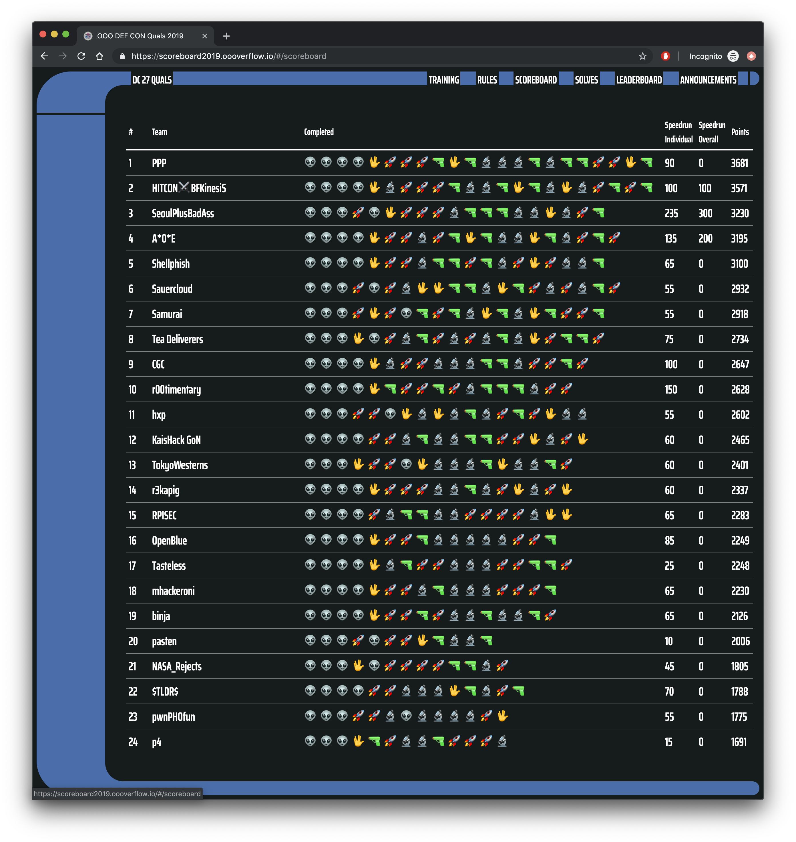

Slide 10
Road to DEF CON 27 CTF
6 qualifying CTFs from around the world
1,200 teams competed in our qualification event in May
Best 16 teams in the world invited to finals, co-located with the DEF CON security conference

Slide 11
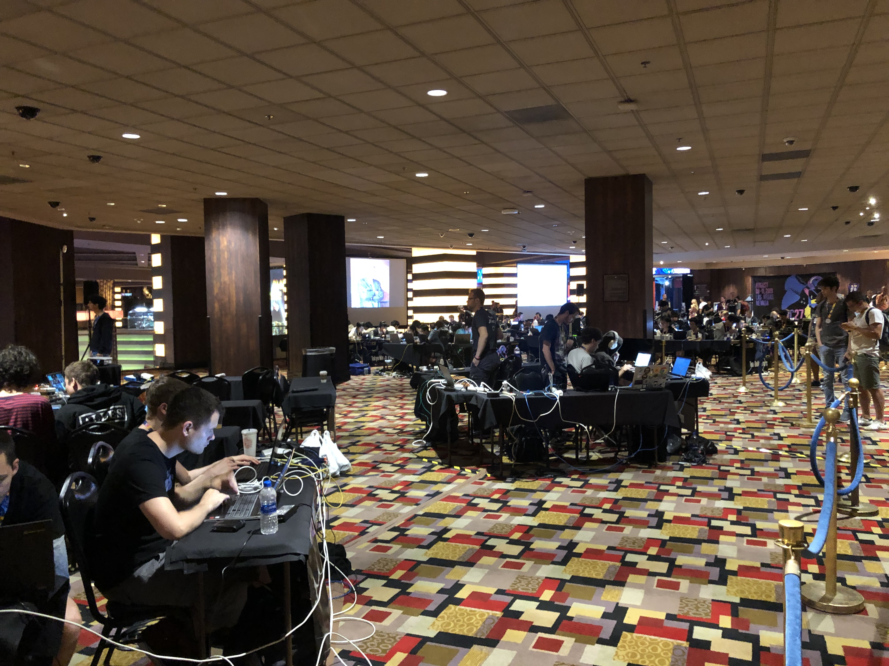

Slide 13
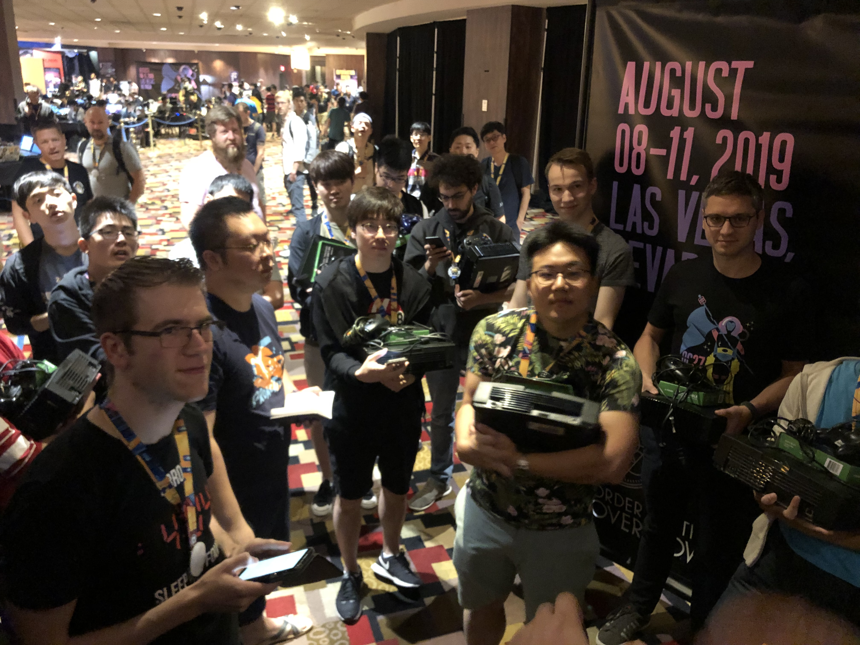

Slide 14
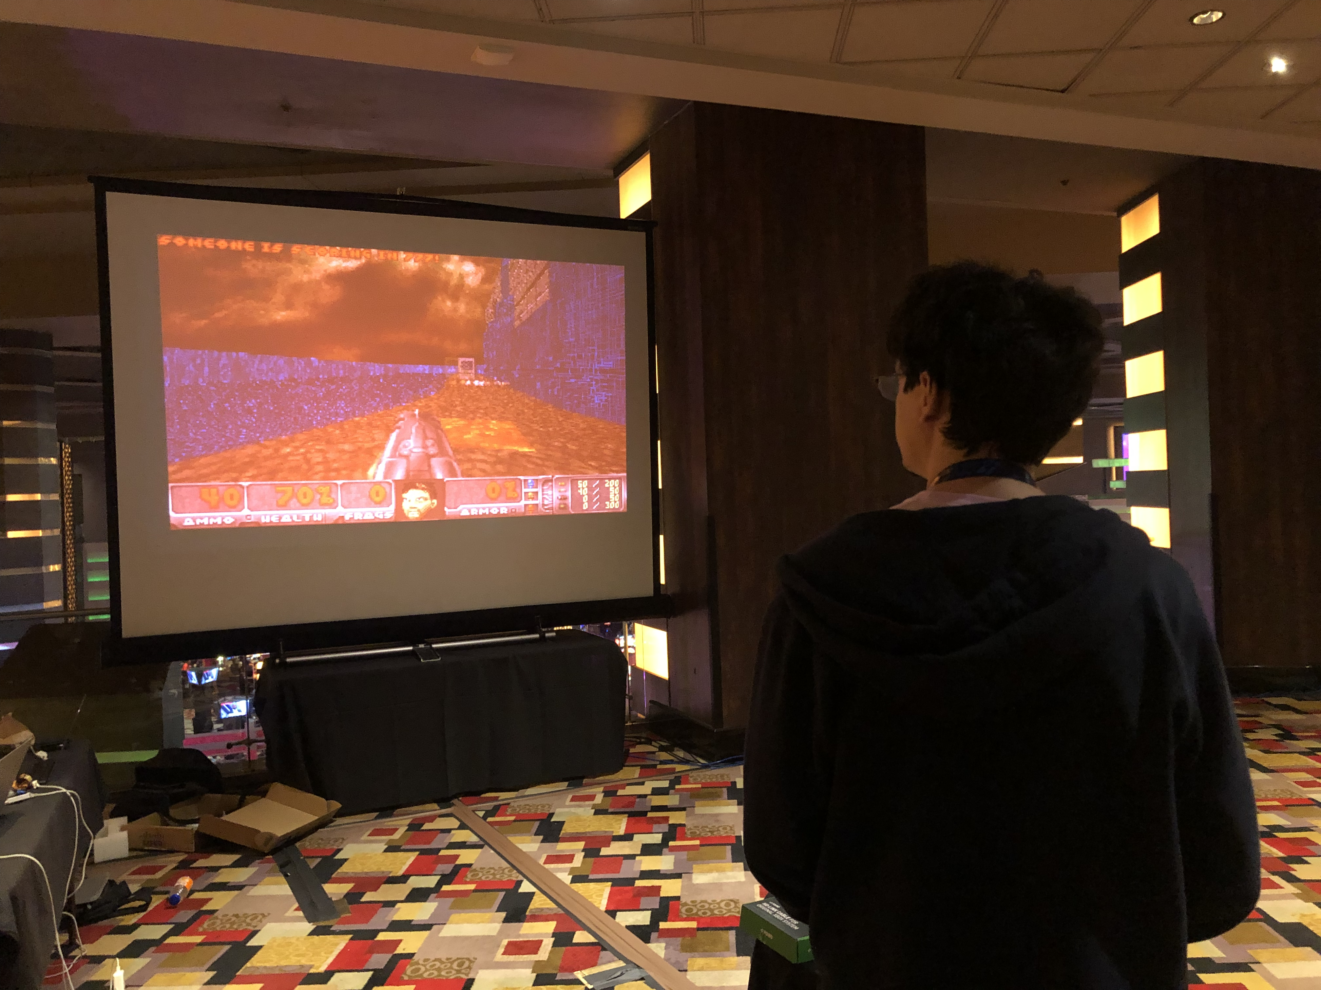

Slide 15
So what did the teams do?
Hacked iOS apps
Via a chat app, similar to telegram
Hacked deep learning models
Neural Networks trained on learning a flag
Hacked Lisp Machine
Lisp Machine (from the early ‘80s) emulator running a web server
Hacked custom Doom running on Xbox
Wrote bit-flip resistant shellcode
…

Slide 17
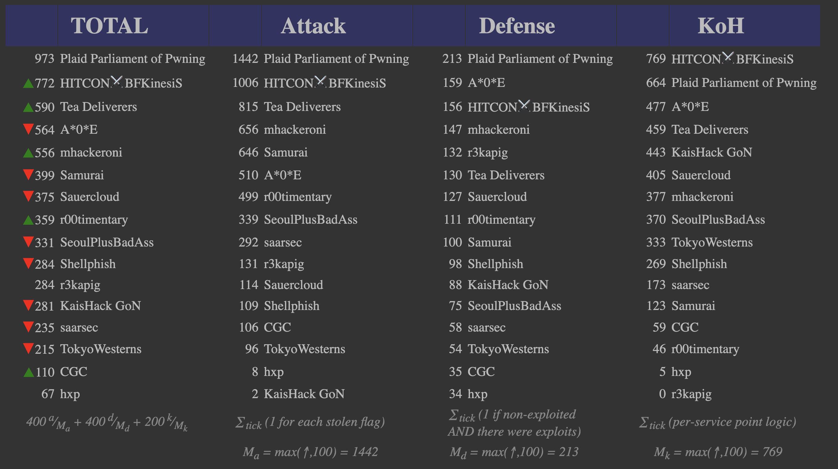

Slide 18
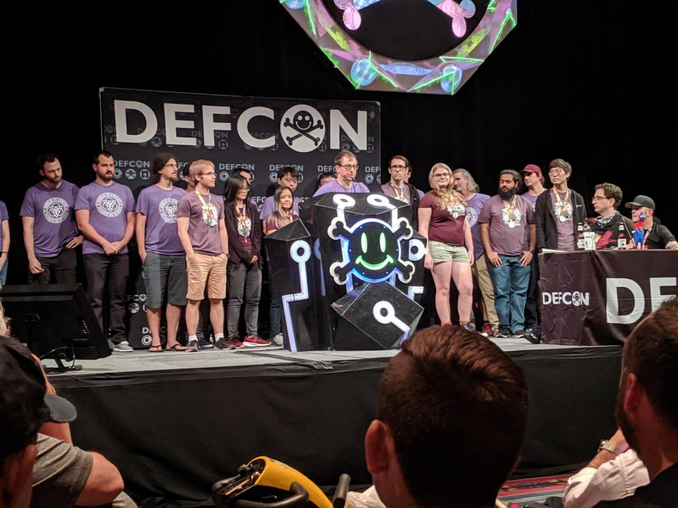

Slide 23
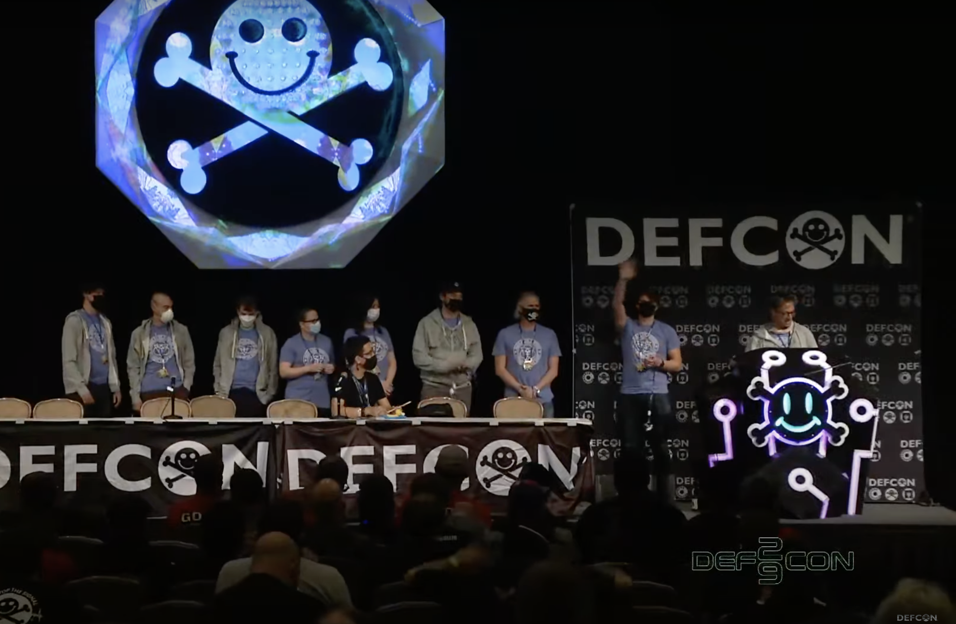

Slide 24
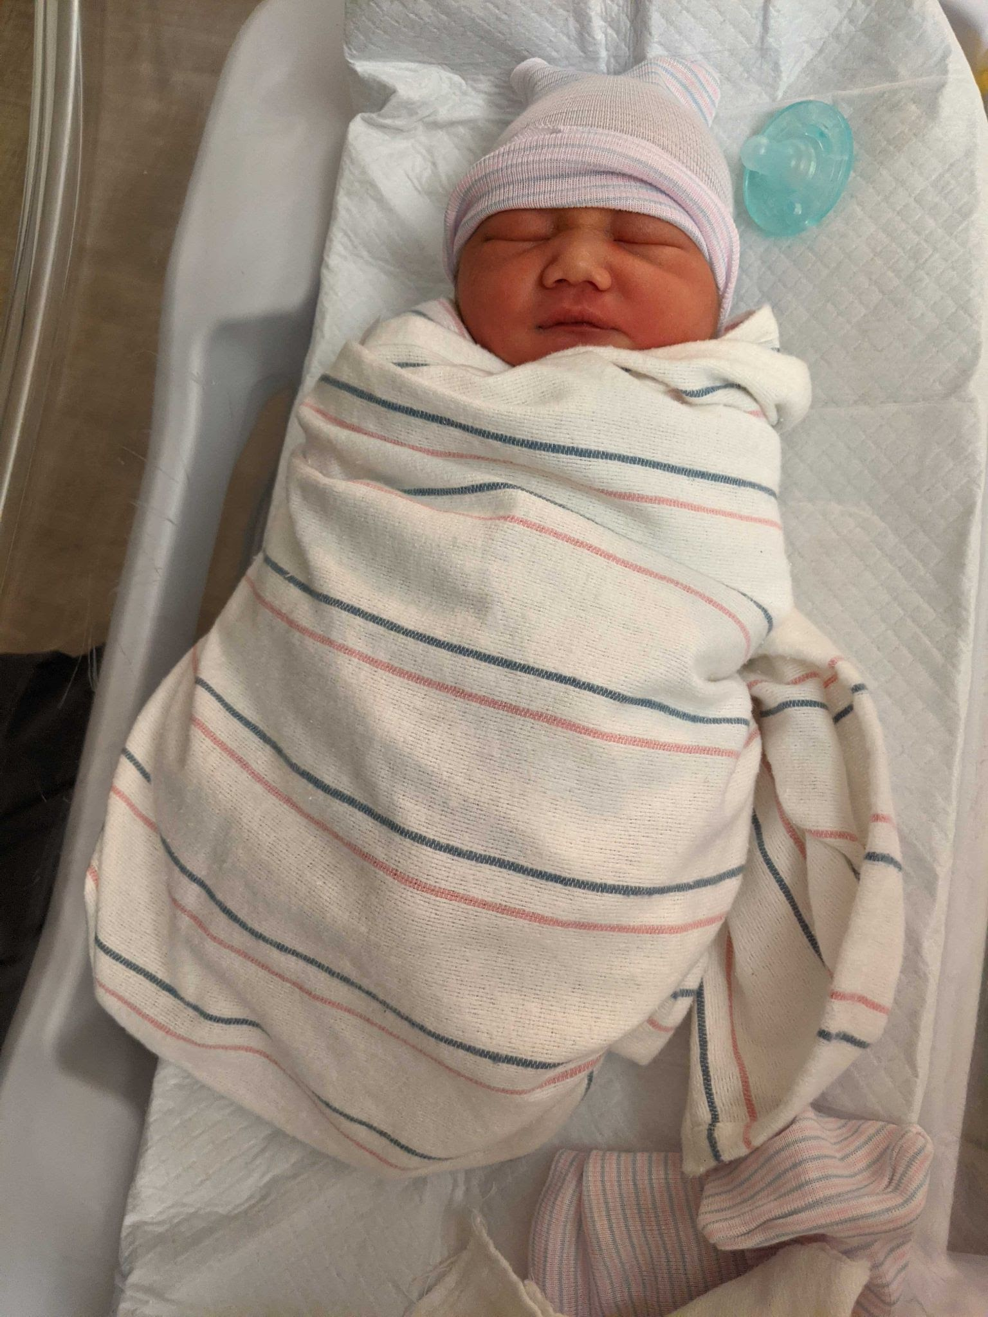

Slide 25
Security @ ASU
Two undergrad Cyber Security concentration programs
BS in computer science
BSE in computer systems engineering
Three graduate Cyber Security concentration programs
MS
MCS
PhD
http://ia.asu.edu/education.php

Slide 26
Security @ ASU
Concentration in BS
Minimum of 15 credits in cybersecurity and related areas as technical electives
Required Course
CSE 365 Introduction to Information Assurance
Two from
CSE 466 Computer System Security
CSE 467 Data and Information Security
CSE 468 Network Security
CSE 469 Computer and Network Forensics
Two elective courses

Slide 27
Security @ ASU
NSA and DHS designated ASU and the Cyber Security program a National Center of Academic Excellence in Information Assurance Education

Slide 28
Syllabus
https://cse365.io/policy

